Slide 1
British Airways Reviews
File created on: 4/27/2024 7:51:31 AM

Slide 2
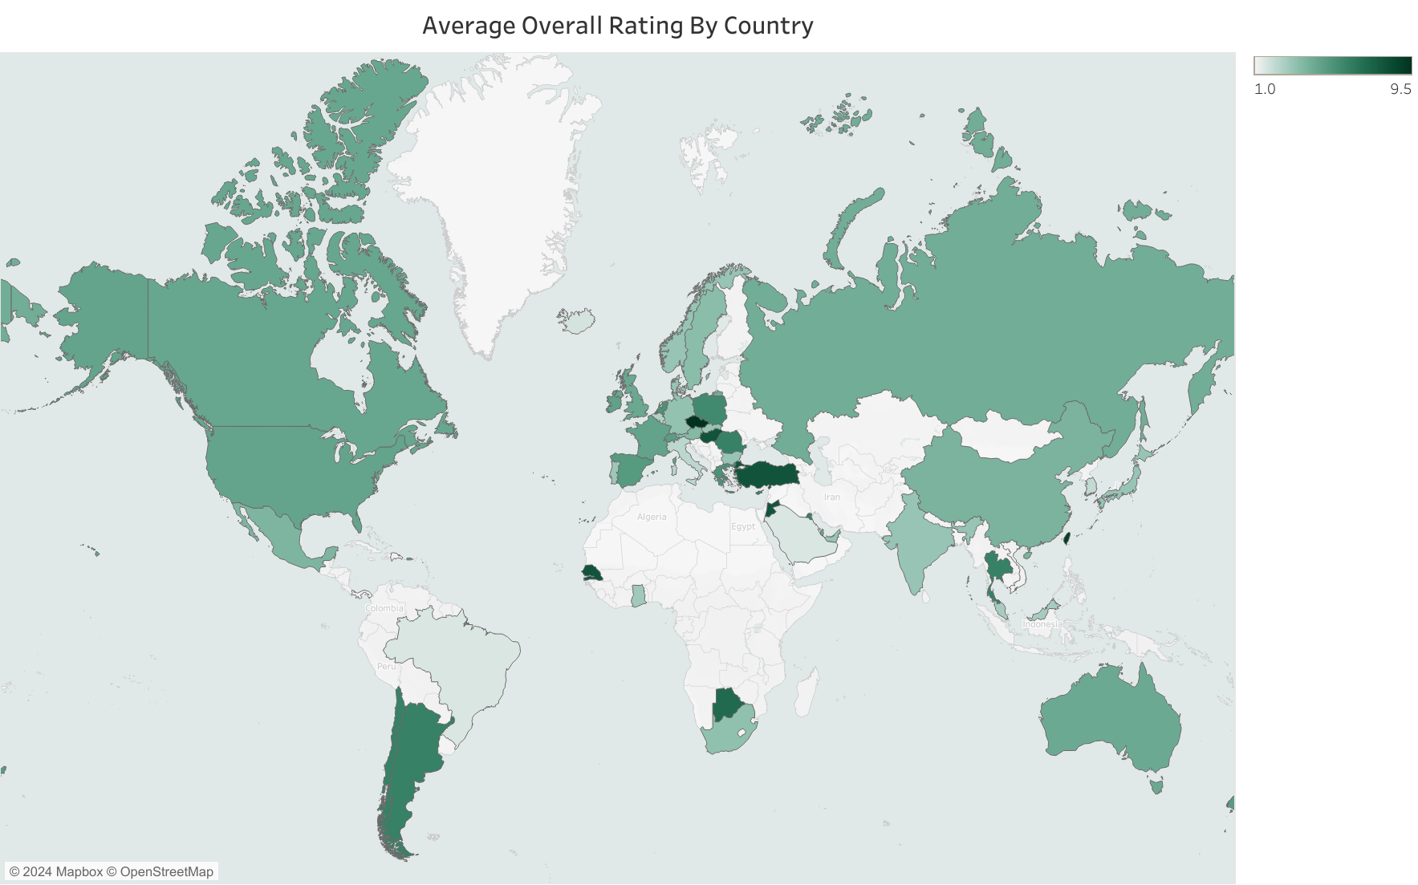

Slide 3
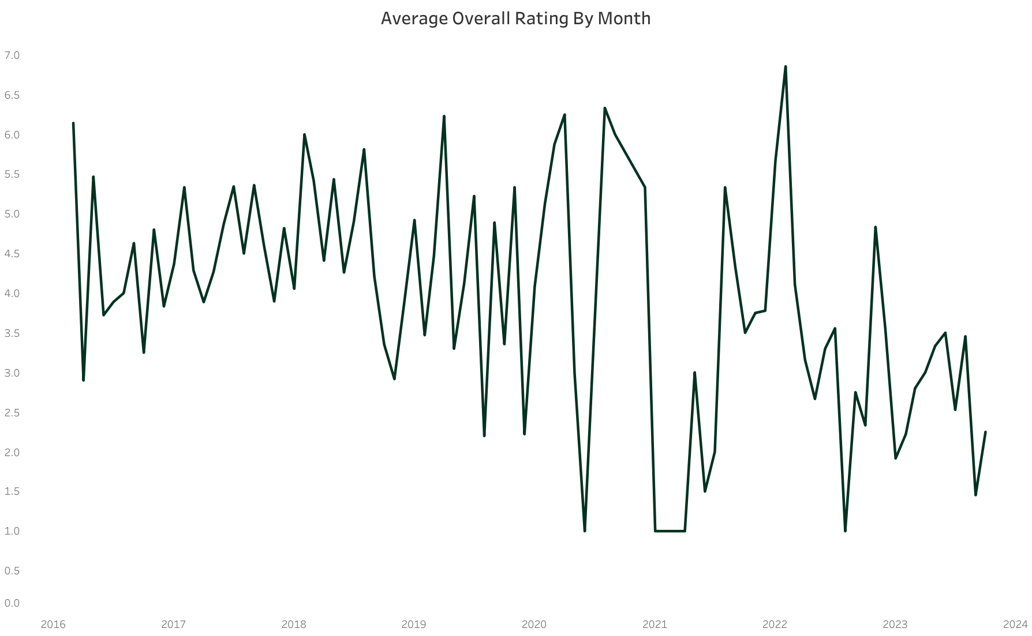

Slide 4
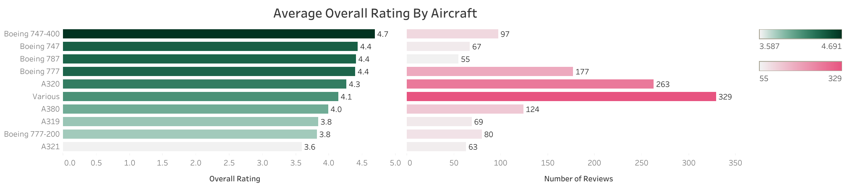

Slide 5
